Slide 1
Pocket Sonar
Android Network Sniffer
Team SSP19/2B
Kan KarJun Alvin 5709659
Liao Weisheng Wilson 6212591
Nyein Soe 5710959
Supervisor
Mr. Premarajan P

Slide 2
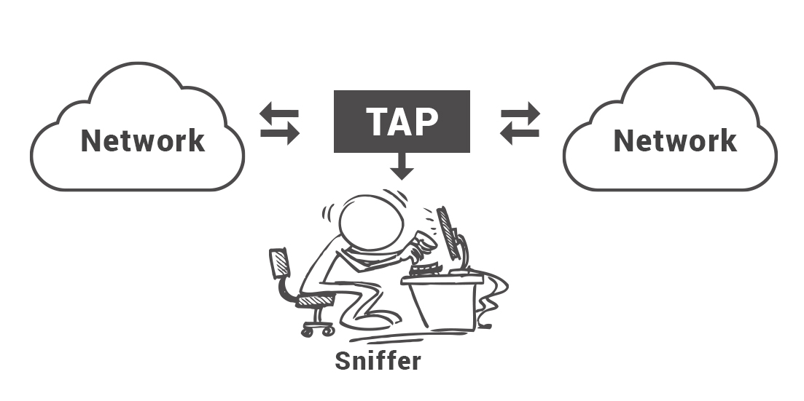
Introduction - What is Pocket Sonar
Pocket Sonar is an android based application used to detect unauthorized devices and the misuse of authorized devices in a network.

Slide 3
Minimum requirement
Armeabi Architecture
512 MB RAM
Android Device
Dual core CPU

Slide 4
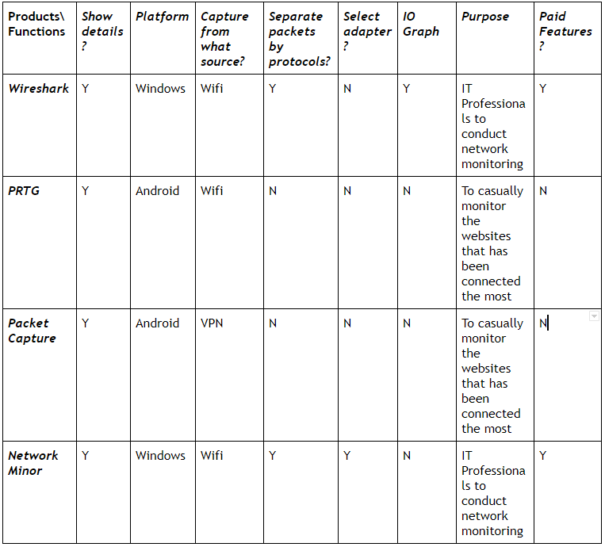
Market Research and Comparison

Slide 5



Once upon a time...

Slide 6
John, the IT administrator, is doing his routine check on PocketSonar on his android device

Slide 7
Using the comparison report, he found the unauthorized device.

Slide 8
He copies the IP address of this device and proceeds to use Trace Route to locate the source

Slide 9
As it turns out, the IP leads to the unauthorized device is connected to an AP in Canteen C

Slide 10
He proceeds to disable physical connection and further investigate the source with security.

Slide 11
Without PocketSonar, would he have been able to detect the unauthorized usage of the network through a portable handheld device?

Slide 12
PocketSonar transform your android device into a powerful network analysis and detection tool in the palm of our hand.

Slide 13
Usage
Sniffing packets
Recording and analyzing traffic
Decrypting packets and displaying in clear text
Converting data to readable format
Showing relevant information (eg. IP, protocol, host or server name)

Slide 14
Other Scenarios
Detection of users accessing restricted websites on authorized device.

Slide 15

Functionalities
Core functions
Scanning unauthorized network
Port Vulnerability Check
Packet Sniff
Other functions
Network Tools
Data export

Slide 16
Functional Requirements/Functionalities (Summary)
Main Menu
Gather background resources
Function
Sub Function
Sub Function

Slide 17
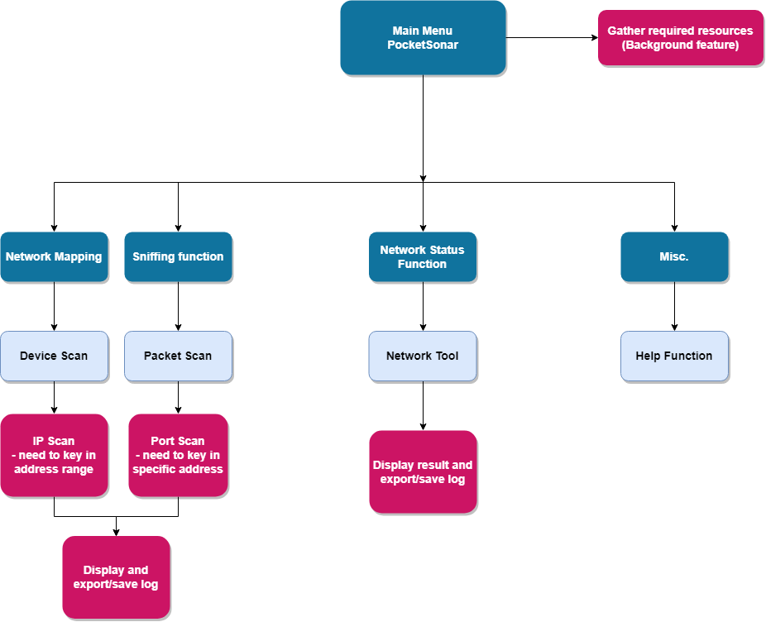

Slide 18

Non-Functional requirements
Software Quality Attributes - aimed to make the program for the IT department so that any IT professionals will be able to use this program.
Capacity - After scanning, the log files saved inside the internal storage of the device does not take much space.
Availability - Pocket Sonar is available at all items, as long as the device is connected to a network

Slide 19

Risk Assessments
 | Impact Type | Proposed management plan
1 | Performance of program is not efficient and hangs | - Programming multi-threaded implementation so that freezing will not occur on the main thread. Have a good programming practice by closing objects and locks that tend to eat up resources
2 | Core functions rely on java libraries | - When creating our Android application, we need to open up to use of compiled binaries so we can fully utilize the linux environment of Android
3 | Rooting | - For this part, if the user wants to root their own android devices, they need to find a rooted phone or the steps required to achieve rooting. On our end we have provided a guide to root Samsung Note 2 4G LTE N7105

Slide 20

Conclusion
Learning objective
Understanding the usage and application of network sniffing
Using a developer tool to create an actual application
Proper project planning and design
-Developer Platform
Android Studio
JAVA
Linux

Slide 21


